Slide 1
CP5804 Week 3
Assessment 4B: Week 3 lab
DUE Sunday 29 March 2020 11:59PM AEST
Assessment 2: Normalisation
DUE Sunday 5 April 2020 11:59PM AEST

Slide 2
Lab 2 review
Make sure to name relationships
Don’t need cardinalities for (0, 1), (1, 1), (0, N), (1, N)
Default choice shouldn’t be to have a strong relationship – consider whether relationships could change.
PKs shouldn’t change
Single-attribute PKs are preferable
Be careful with optionalities
In 1:1 relationships, FK should go on the side that mandatorily participates in the relationship

Slide 3
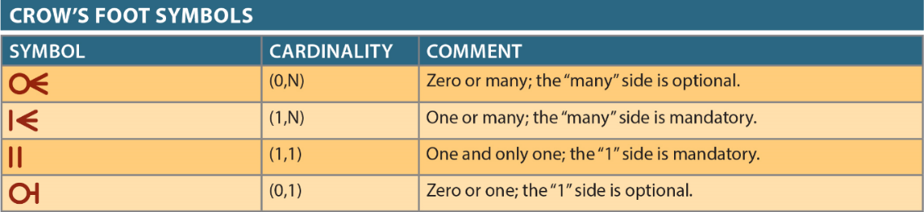

Slide 4
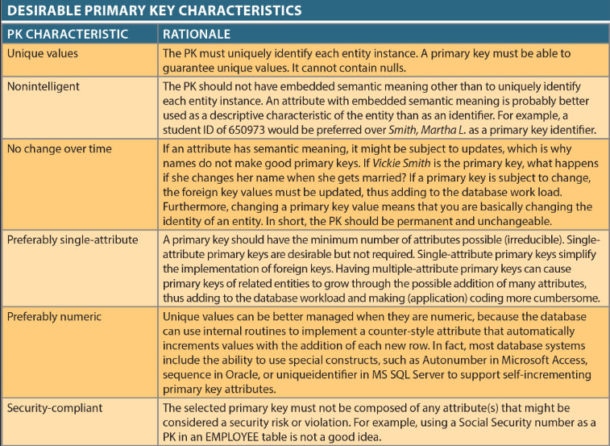

Slide 5
Normalisation
Normalisation is the process for evaluating and correcting table structures to minimise data redundancies and to reduce data anomalies
During the normalisation process, we analyse the relationship among the attributes within each entity. Attributes are assigned to each table based on determination
After normalisation, each table is free from anomalies of insertion, update, and deletion
Normalisation improves the existing data structures and creates an appropriate database design.

Slide 6
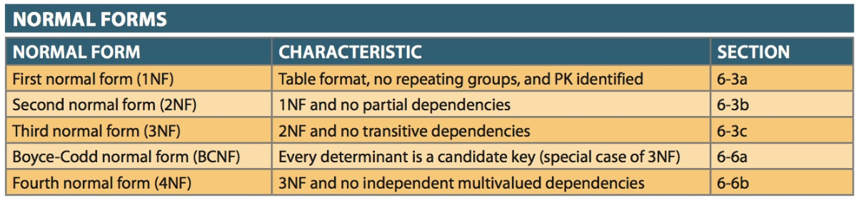
Normalisation

Slide 7
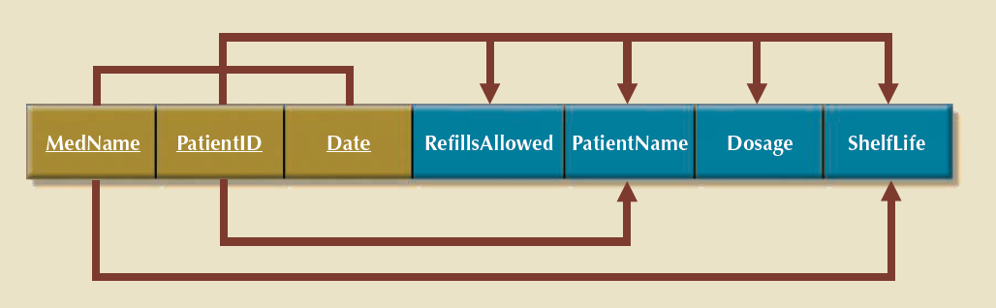
Normalisation exercise
MEDICINE (MedName, ShelfLife)
PATIENT (PatientId, PatientName)
PRESCRIPTION (MedName, PatientID, Date, RefillsAllowed, Dosage)

Slide 8
1NF
P
Remove partial dependencies by creating new tables
P
3NF
3NF
PATIENT
MEDICINE
3NF
Don’t forget the original table, with the dependent attributes now removed
PRESCRIPTION

Slide 9
P
P
PATIENT
MEDICINE
We add a surrogate key, MedID, to MEDICINE as textual PKs are usually not a good choice. This also becomes a PK/FK in PRESCRIPTION
PRESCRIPTION

Slide 10
T
P
P
Original data has repeating groups, so not even in 1NF. We fill the table out and identify the PK to reach 1NF.

Slide 11
We split out partial dependencies to new tables to get to at least 2NF (and create a new AwardId surrogate key). We still have a transitive dependency in the ACTOR table.
3NF
2NF
MOVIE
ACTOR
T
3NF
3NF
ACTOR_AWARD
AWARD

Slide 12
We create a new table AGENT to remove the transitive dependency from ACTOR, and create a surrogate key, as AgentName is not a good PK. All tables are now in 3NF.
MOVIE
ACTOR
ACTOR_AWARD
AGENT
AWARD

